Slide 1

BULLYING-VICTIMISATION and Teacher–student relationships: roles in adolescents’ future academic aspirations.
Kashish Gupta

Slide 2
Structure
What?
Overview
Bullying-Victimisation
Teacher–Student Relationships
How?
The Study
Data
Analysis
And?
Findings
Context
So?
Implications
What Now?
Future Academic Aspirations

Slide 3




Overview
Bullying
What does it look like?
How prevalent is it?
What is the damage?
Future Academic Aspirations
Cognitive Mechanisms
Internalisation
Externalisation
Teacher–Student Relationships
What does a strong relationship involve?
How do strong relationships help?
Bullying
Future Academic Aspirations
Other Considerations
Age
Sex
This Photo by Unknown Author is licensed under CC BY-NC-ND
This Photo by Unknown Author is licensed under CC BY-SA

Slide 4
Hypotheses
Predict Future Academic Aspirations
Hypothesis 1
Bullying-Victimisation
Hypothesis 3
Age
Sex
Hypothesis 2
Teacher–Student Relationships
(negative)
(Females)
(positive)

Slide 5
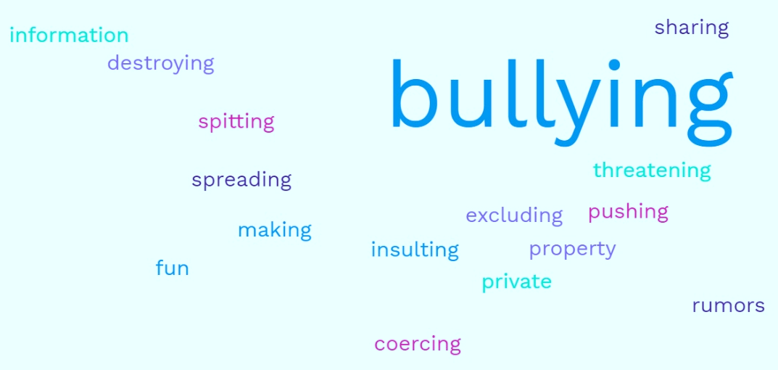
Data
School Crime Supplement (2019)
Open Access Secondary Data
Collected by the US Government
National Crime Victimisation Survey (2019)
Future Academic Aspirations
Graduating from higher education?
Yes/No
Level of Adult Support
Cares, Listens, Good Job
4-point Likert: level of agreement
Frequency of Bullying-Victimisation
Days in academic year
1
2-5
6-10
10+
N = 488
Ages 12-18

Slide 6
Analysis and Findings
Correlation
Hierarchical Multiple Linear Regression Model.
Three Stages for each hypothesis
R & RStudio
Stage 1
Age
Sex
Stage 2
Frequency of Bullying-Victimisation
Age
Step 3
Level of Adult Support
Frequency of Bullying-Victimisation
Sex
Age
Sex

Slide 7
Analysis and Findings
Correlation
Hierarchical Multiple Linear Regression Model.
Three Stages for each hypothesis
R & RStudio
Sex
Teacher–Student Relationships
Age
Bullying-Victimisation
Hypothesis 1
Partial Support
✓ Sex
Hypothesis 2
No Support
✓ Sex
Hypothesis 3
Full Support
✓ Adult Support
✗ Age
✗ Age
✗ Bullying
✗ Sex
✗ Age
✗ Bullying
Stage 1
Age
Sex
Stage 2
Frequency of Bullying-Victimisation
Age
Step 3
Level of Adult Support
Frequency of Bullying-Victimisation
Sex
Age
Sex

Slide 8
Contextualising, Implications and Future Directions
Females
Sole predictor Stages 1 & 2
Not in Stage 3
Why is this important?
Frequency of Bullying
Not a predictor
Why?
Poor measure?
Adult Support
Sole predictor
What does this mean?
The importance of strong Teacher–Student Relationships
Future Academic Aspirations
General wellbeing and future outlook
Long-term benefits
Sex and Age
Females and Males
Why the discrepancy?
Bridging the gap
Non-linear age patterns?
Internalising
&
Externalising

Slide 9
References and Thank You.
National Crime Victimization Survey: School Crime Supplement, [United States], 2019. https://www.icpsr.umich.edu/web/NACJD/studies/37816/versions/V1
Thank You.

